Slide 1
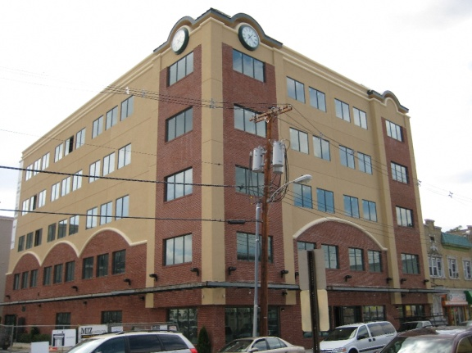
Lakewood Resource & Referral Center
212 SECOND STREET, SUITE 204
LAKEWOOD, NEW JERSEY 08701
Notes:
1

Slide 2
LRRC WELCOMES
Lakewood, New Jersey
Nonprofit & Faith Based
Agencies
Presented by
JAY B. BRAUN, L. S. W., M. S. W, M. S. ED.
DIRECTOR
LAKEWOOD RESOURCE AND REFERRAL CENTER
SOCIAL SERVICES INFORMATION & REFERRAL DIVISION
Notes:
2

Slide 3
MISSION STATEMENT
Social Services Information And Referral (SSIRD) Division;
To provide the entire community with the most comprehensive, accurate and empathetic social services, information, referral, assistance and advocacy, for governmental entitlement and private sector programs throughout the entire spectrum of the human lifecycle experience. We strive to assess the total situation and needs of individuals and families and do not stop with the initial inquiry of issue or problem.
Center For Health Education Medicine And Dentistry (CHEMED) Division;
To implement a comprehensive, integrated system of health care to optimize the physical and mental well being of individuals and families in our community by delivering outstanding health education, preventative, and treatment services.
To ensure that state of the art quality services are available and accessible to all individuals and families regardless of their medical/dental healthcare coverage status.
Notes:
3

Slide 4
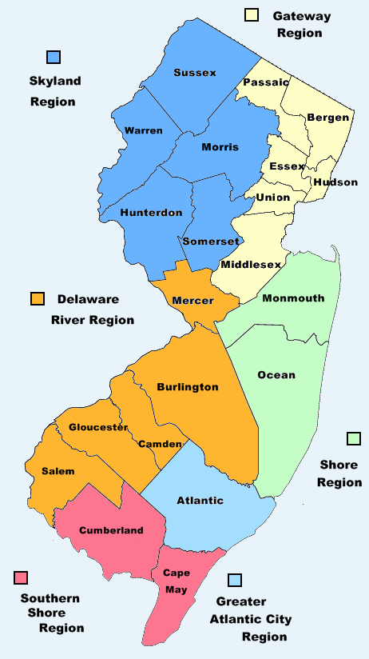
About LRRC
THE LRRC PROVIDES A COMPREHENSIVE RANGE
OF FREE SOCIAL SERVICES FOR
Lakewood Township
Ocean County
New Jersey
Notes:
4
4

Slide 5
Lakewood, OCEAN COUNTY Need
UNAFFORDABLE HOUSING
INADEQUATE HOUSING
LACK OF HEALTHCARE COVERAGE
LACK OF PROPER NUTRITION
INCREASED ENERGY COSTS
POVERTY
LACK OF EMPLOYMENT
LACK OF ADVOCACY
POPULATION EXPLOSION

Slide 6
PROGRAM AREAS
Notes:
We should include CHEMED data

Slide 7
Lrrc - STAFF EXPERTISE
AMERICAN RECOVERY & REINVESTMENT ACT
AFFORDABLE & FAIR HOUSING
HEALTHCARE PLANS
NUTRITION SUPPLEMENTATION PROGRAMS
UTILITIES BILL & EQUIPMENT ASSISTANCE
CDC VACCINATIONS IMMUNIZATION COMPLIANCE
CREDIT COUNSELING
DISABILITY INSURANCE
EMPLOYMENT COUNSELING
CUSTOM RESUME’S
LEAD POISONING PREVENTION

Slide 8
HOUSING PROGRAMS
SECTION 8 HOMEOWNERSHIP PROGRAM
FAMILY SELF SUFFICIENCY PROGRAM
SECTION 8 PUBLIC HOUSING
SECTION 8 HOUSING CHOICE VOUCHER (RENTAL) PROGRAM
AFFORDABLE HOUSING INITIATIVE PURCHASE PROGRAM

Slide 9
HOUSING PROGRAMS affiliates
SOLUTIONS TO END POVERTY SOON
MIKE MCNEIL
AFFORDABLE HOUSING OFFICER
LANDLORD TENANT MEDIATION
CODE VIOLATIONS
TENANT EDUCATION
LANDLORD EDUCATION
AFFORDABLE HOUSING INITIATIVE
HOUSING WORKSHOPS

Slide 10
HEALTHCARE PROGRAMS
NJ FAMILY CARE ALL STATE & COUNTY PLANS
MEDICAID / MEDICARE PLANS
CDC VACCINE PROGRAM
PRESCRIPTION ASSISTANCE

Slide 11
NUTRITIONAL PROGRAMS
SUPPLEMENTAL NUTRITION PROGRAM
WIC (Women, Infants, and Children)
FOOD PANTRIES & SOUP KITCHENS

Slide 12
UTILITY ASSISTANCE PROGRAMS
HEAP
USF
WEATHERIZATION
COMFORT PARTNERS
NJ SHARES
TRUST PROGRAM

Slide 13
2009 Statistics
24,677
Total
Encounters

Slide 14
PROGRAM AREAS

Slide 15
NJDOHSS (CDC) VACCINATION GRANT
PILOT PROGRAM
In January 2008 the LRRC was granted the opportunity to work along with the NJDOHSS to obtain data as to why families are not immunizing their children and help increase awareness in the Ocean County population of the importance of vaccines.

Slide 16
RESULTS TO DATE
Obtained data on 3,420 children; 2,334 families
Reached out to 1,560 families
Communicated with 974 families
664 families have been brought up to date in the CDC recommended vaccine schedules
310 families have stated they will schedule appointments with their doctors to receive the missing vaccinations.
Abstract submitted & accepted for Poster Presentation,
CDC 44th Annual Immunization Conference, Atlanta GA.

Slide 17
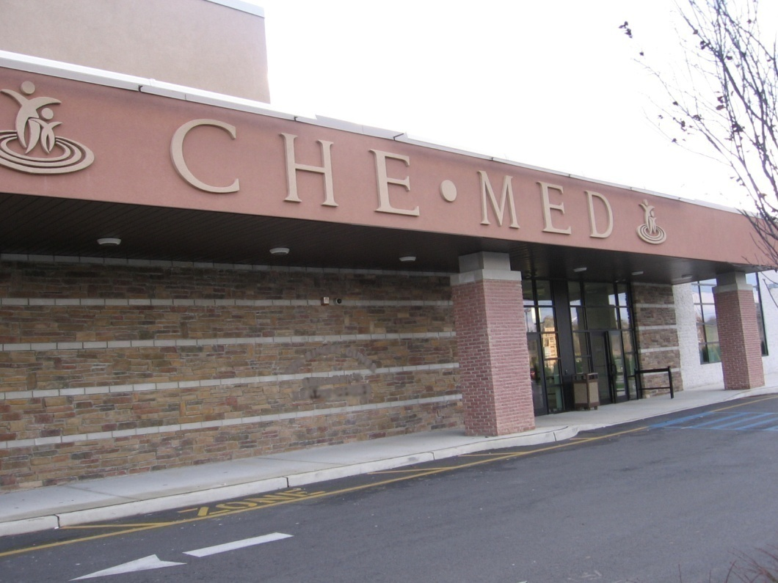
In February 2008 the LRRC opened its Health Center, The Center for Health Education, Medicine & Dentistry (CHEMED) to the community with Adult, Pediatrics and Behavioral health departments to fill the unmet need.

Slide 18
AMERICAN RECOVERY & REINVESTMENT ACT (ARRA)
Feb. 13, 2009, Congress passed the American Recovery and Reinvestment Act of 2009
UNITED STATES OF AMERICA
THE ADMINISTRATION FOR CHILDREN AND FAMILIES’
OFFICE OF COMMUNITY SERVICES (ACF/OCS)
STRENGTHENING COMMUNITIES FUND (SCF)

Slide 19
ARRA GENERAL, SCOPE
CREATE NEW JOBS AS WELL AS SAVE EXISTING ONES
SPUR ECONOMIC ACTIVITY AND INVEST IN LONG-TERM
ECONOMIC GROWTH
FOSTER ACCOUNTABILITY AND TRANSPARENCY IN
GOVERNMENT SPENDING
PROVIDING $288 BILLION IN TAX CUTS AND BENEFITS
FOR MILLIONS OF WORKING FAMILIES AND BUSINESSES

Slide 20
ARRA GENERAL, SCOPE CON’T
INCREASING FEDERAL FUNDS FOR EDUCATION AND HEALTH CARE
EXTENDED ENTITLEMENT PROGRAMS (SUCH AS EXTENDING
UNEMPLOYMENT BENEFITS) BY $224 BILLION
MAKING $275 BILLION AVAILABLE FOR FEDERAL CONTRACTS,
GRANTS AND LOANS
REQUIRING RECIPIENTS OF RECOVERY FUNDS TO REPORT
QUARTERLY ON THE AMOUNT OF MONIES SPENT, THE STATUS
OF THE PROJECT, THE NUMBER OF JOBS CREATED AND/OR SAVED

Slide 21
ARRA GENERAL GOALS
BOOST EMPLOYMENT AND THE ECONOMY
REDUCE TAXES
INCREASE FEDERAL ENTITLEMENT BENEFITS
BUILD & FIX AILING INFRASTRUCTURE
INCREASE COLLEGE AFFORDABILITY
COMPUTERIZE HEALTH RECORDS
EXPAND CHILD TAX CREDITS
WEATHERIZATION OF FEDERAL BUILDINGS & PRIVATE HOMES

Slide 22
LRRC, ARRA PARTICIPATION
VOLUNTARY
MUTUALLY AGREEABLE GOALS
ON SITE & OFF SITE
MUTUALLY AGREEABLE TIMES
YOUR DESIGNATED STAFF
CONTINUOUS MEASURE OF PROGRESS

Slide 23
LRRC, ARRA ORGANIZATIONS TARGET
COMMUNITY OUTREACH
COLLABORATION
ENGAGEMENT
IMPROVE ACCESS TO SERVICE
PROMOTE CULTURAL SENSITIVITY

Slide 24
LRRC, ARRA ORGANIZATIONS SERVICES
ORGANIZATIONAL ASSESSMENT
STAFF TRAINING
ONGOING TECHNICAL ASSISTANCE
RESEARCH FOR ARRA FUNDING
CULTURAL COMPETENCY TRAINING

Slide 25
LRRC, ARRA METHODOLOGY
ORGANIZATIONAL ASSESSMENT TOOL
CURRENT AREAS OF SERVICES
IDENTIFIED AREAS TO ENHANCE & IMPROVE
CURRENT SERVICES
IDENTIFIED AREAS OF DESIRED EXPANSION

Slide 26
ARRA INCREASED $ - NEW PROGRAMS
AMERICAN OPPORTUNITY TAX CREDIT
BUSINESS PROVISIONS
CHILD TAX CREDIT
EARNED INCOME CREDIT
FIRST TIME HOMEBUYERS TAX CREDIT
HOME AFFORDABILITY

Slide 27
ARRA INCREASED $ - NEW PROGRAMS CON’T
MORTGAGE STABILIZATION PROGRAM
PELL GRANTS
RESIDENTIAL ENERGY EFFICIENCY PROPERTY CREDIT
SOCIAL SERVICES FOR THE HOMELESS
SOCIAL SECURITY & SSI
UNEMPLOYMENT BENEFITS
VEHICLE SALES TAX REDUCTION

Slide 28
QUESTIONS & ANSWERS

Slide 29
Thank You!

